Slide 1
Big Talk
Application Ideas

Slide 2
What is the Big Talk Graphic?
It is a large conversation bubble that may have a direction above it, asking a student to watch and explain what a certain character is trying to say or do in a story or film.
Start with “You are”….and asking the student to write using the words, “I am…..”
Give different students different people/subjects to watch, or let them choose their character to watch. (If you assign characters to students as you pass out the Big Talk assignment sheets, you can differentiate the character assignments by difficulty level for the writing.)

Slide 3
To use The “Big Talk” Graphic--
You can use 3 or 4 character names on Big Talk graphics. Give different roles to different students, according to ability.
01
Assign: “You are (one character)! What do you think about the situation or issue?”
02
Distribute the roles in the assignment based on student writing skills.
03
Have them write in 1st person instead of about the character!
04

Slide 4
You may even use a strategy to help students see another’s perspective
A great film example is in “Freedom Writers” when teacher Erin Gruwell had students line up in their two opposing groups, facing each other, and had them respond to their personal histories in common by moving closer as they shared similar lived realities.
Ask your students, “How would you feel if….” and read stories, tell about historical events, see a film, and ask them to respond as if a single character in that narrative. “Romeo and Juliet” and “Julius Caesar” are good high school examples.
Possibly use a “Big Talk” graphic, (next slide) giving each student a different person to watch or follow in a film, story, or historical event and write a first person viewpoint of their thoughts.

Slide 5
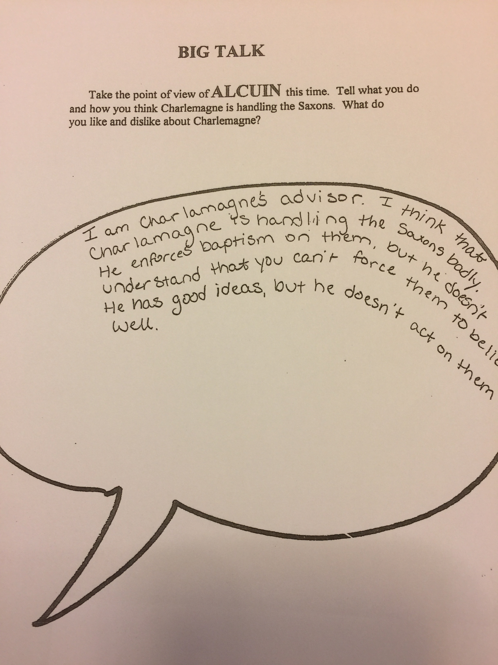
Take the role of……

Slide 6
Some other ways to use “Big Talk”
For elementary students, let them be the voice of characters with different points of view, such as “The True Story of the Three Little Pigs,” or “Charlotte’s Web.”
For films set in a school setting at the secondary level, have them pick their own characters from “Stand and Deliver,” “Renaissance Man,” or Freedom Writers.” (These films are especially useful when you have a class with dysfunctional class divisions to build rapport.)
You can even use “Big Talk” to have students write in the first person about their feelings about a specific topic.

